Slide 1
16-BIT SUBTRACTION
EXP NO: 6
AIM:To write an assembly language program to implement 16-bit division using 8086 processor.
ALGORITHM: 1) Start the program by loading a register pair with the address of memory location. 2) Move the data to a register. 3) Get the second data and load it into the accumulator. 4) Subtract the two register contents. 5) Increment the value of the carry. 6) Check whether the repeated subtraction is over. 7) Store the value of quotient and the reminder in the memory location. 8) Halt.
PROGRAM:
LHLD 2050
XCHG
LHLD 2052
MVI C,00
MOV A,E
SUB L
STA 2054
MOV A,D
SUB H
STA 2055
HLT

Slide 2
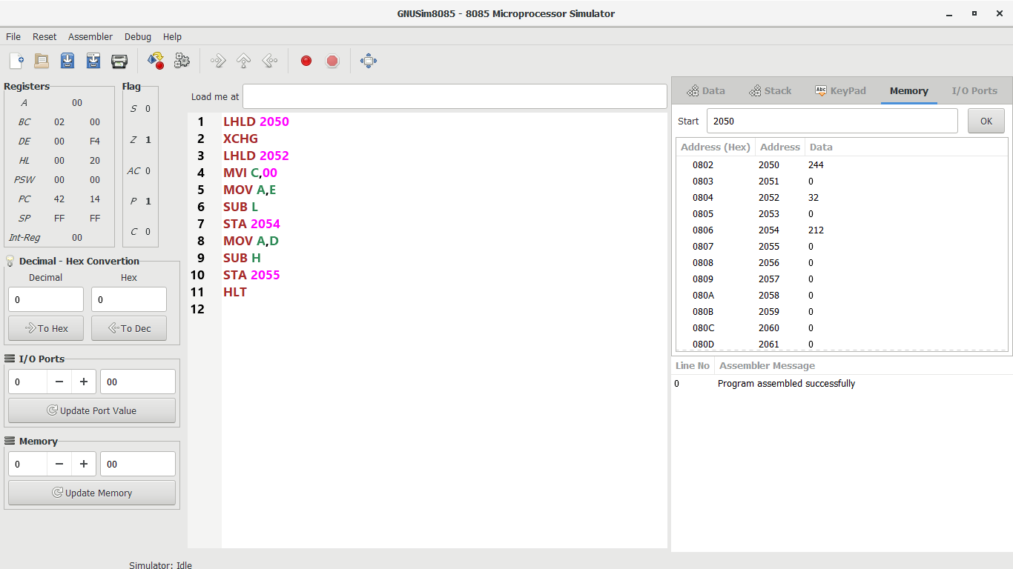
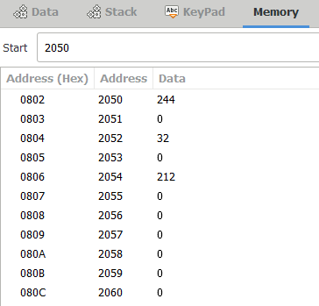
INPUT:
OUTPUT:

Slide 3
RESULT: Thus the program was executed successfully using 8086 processor simulator.

